Slide 1


Architecture
Discussion
Titan
Camp
Gevorg Martirosyan

Slide 2

Business Needs

Slide 3
Main Pain Points (1 / 3)
Large number of booking are not canceled
Hard to manage 20+ traveler groups using Excel files
Travel costs/quotes are being calculated by hand on a piece of A4 paper

Slide 4
Main Pain Points (2 / 3)
Keeping track of expenses during a tour
Keeping track of individual bookings that are part of a tour
Having to manage a quote with options and what needs to be actually booked / confirmed to be booked by the guest(s)

Slide 5
Main Pain Points (3 / 3)
Keeping track of which employee at the travel agency did what
Customers are not being notified about status updates on their trip/booking
Have an overview of pricing for accounting to make sure the invoices issued by vendors match the initial arrangement

Slide 6
Existing Solutions
They are focused more around accounting/CRM
Are tailored for outgoing tourism, not incoming

Slide 7
Goal
Create an open-source web based software solution for travel agencies specialized on incoming tourism to help them manage their customers, bookings and help them save money by avoiding booking penalties due to late cancellations.

Slide 8
TRAVELY 1.0

Slide 9

Manage Tours
Manage bookings and booking confirmations
Remind about booking cancellations
Manage hotels profiles and their details / Import from Excel
Manage activity provider profiles / Import from Excel
Manage travelers / groups about limitations and health issues
Roles based user access
Create/manage reusable tour packages

Slide 10
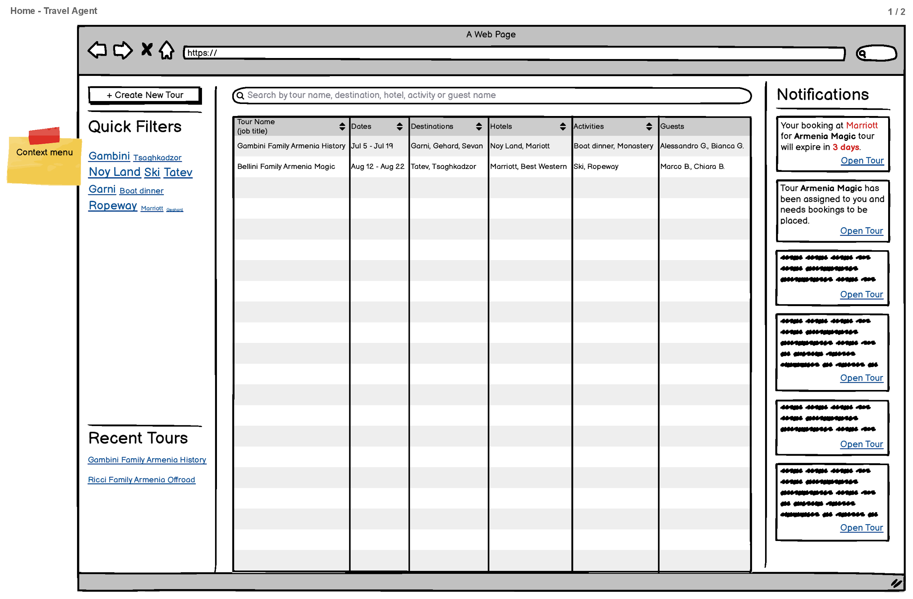

Slide 11
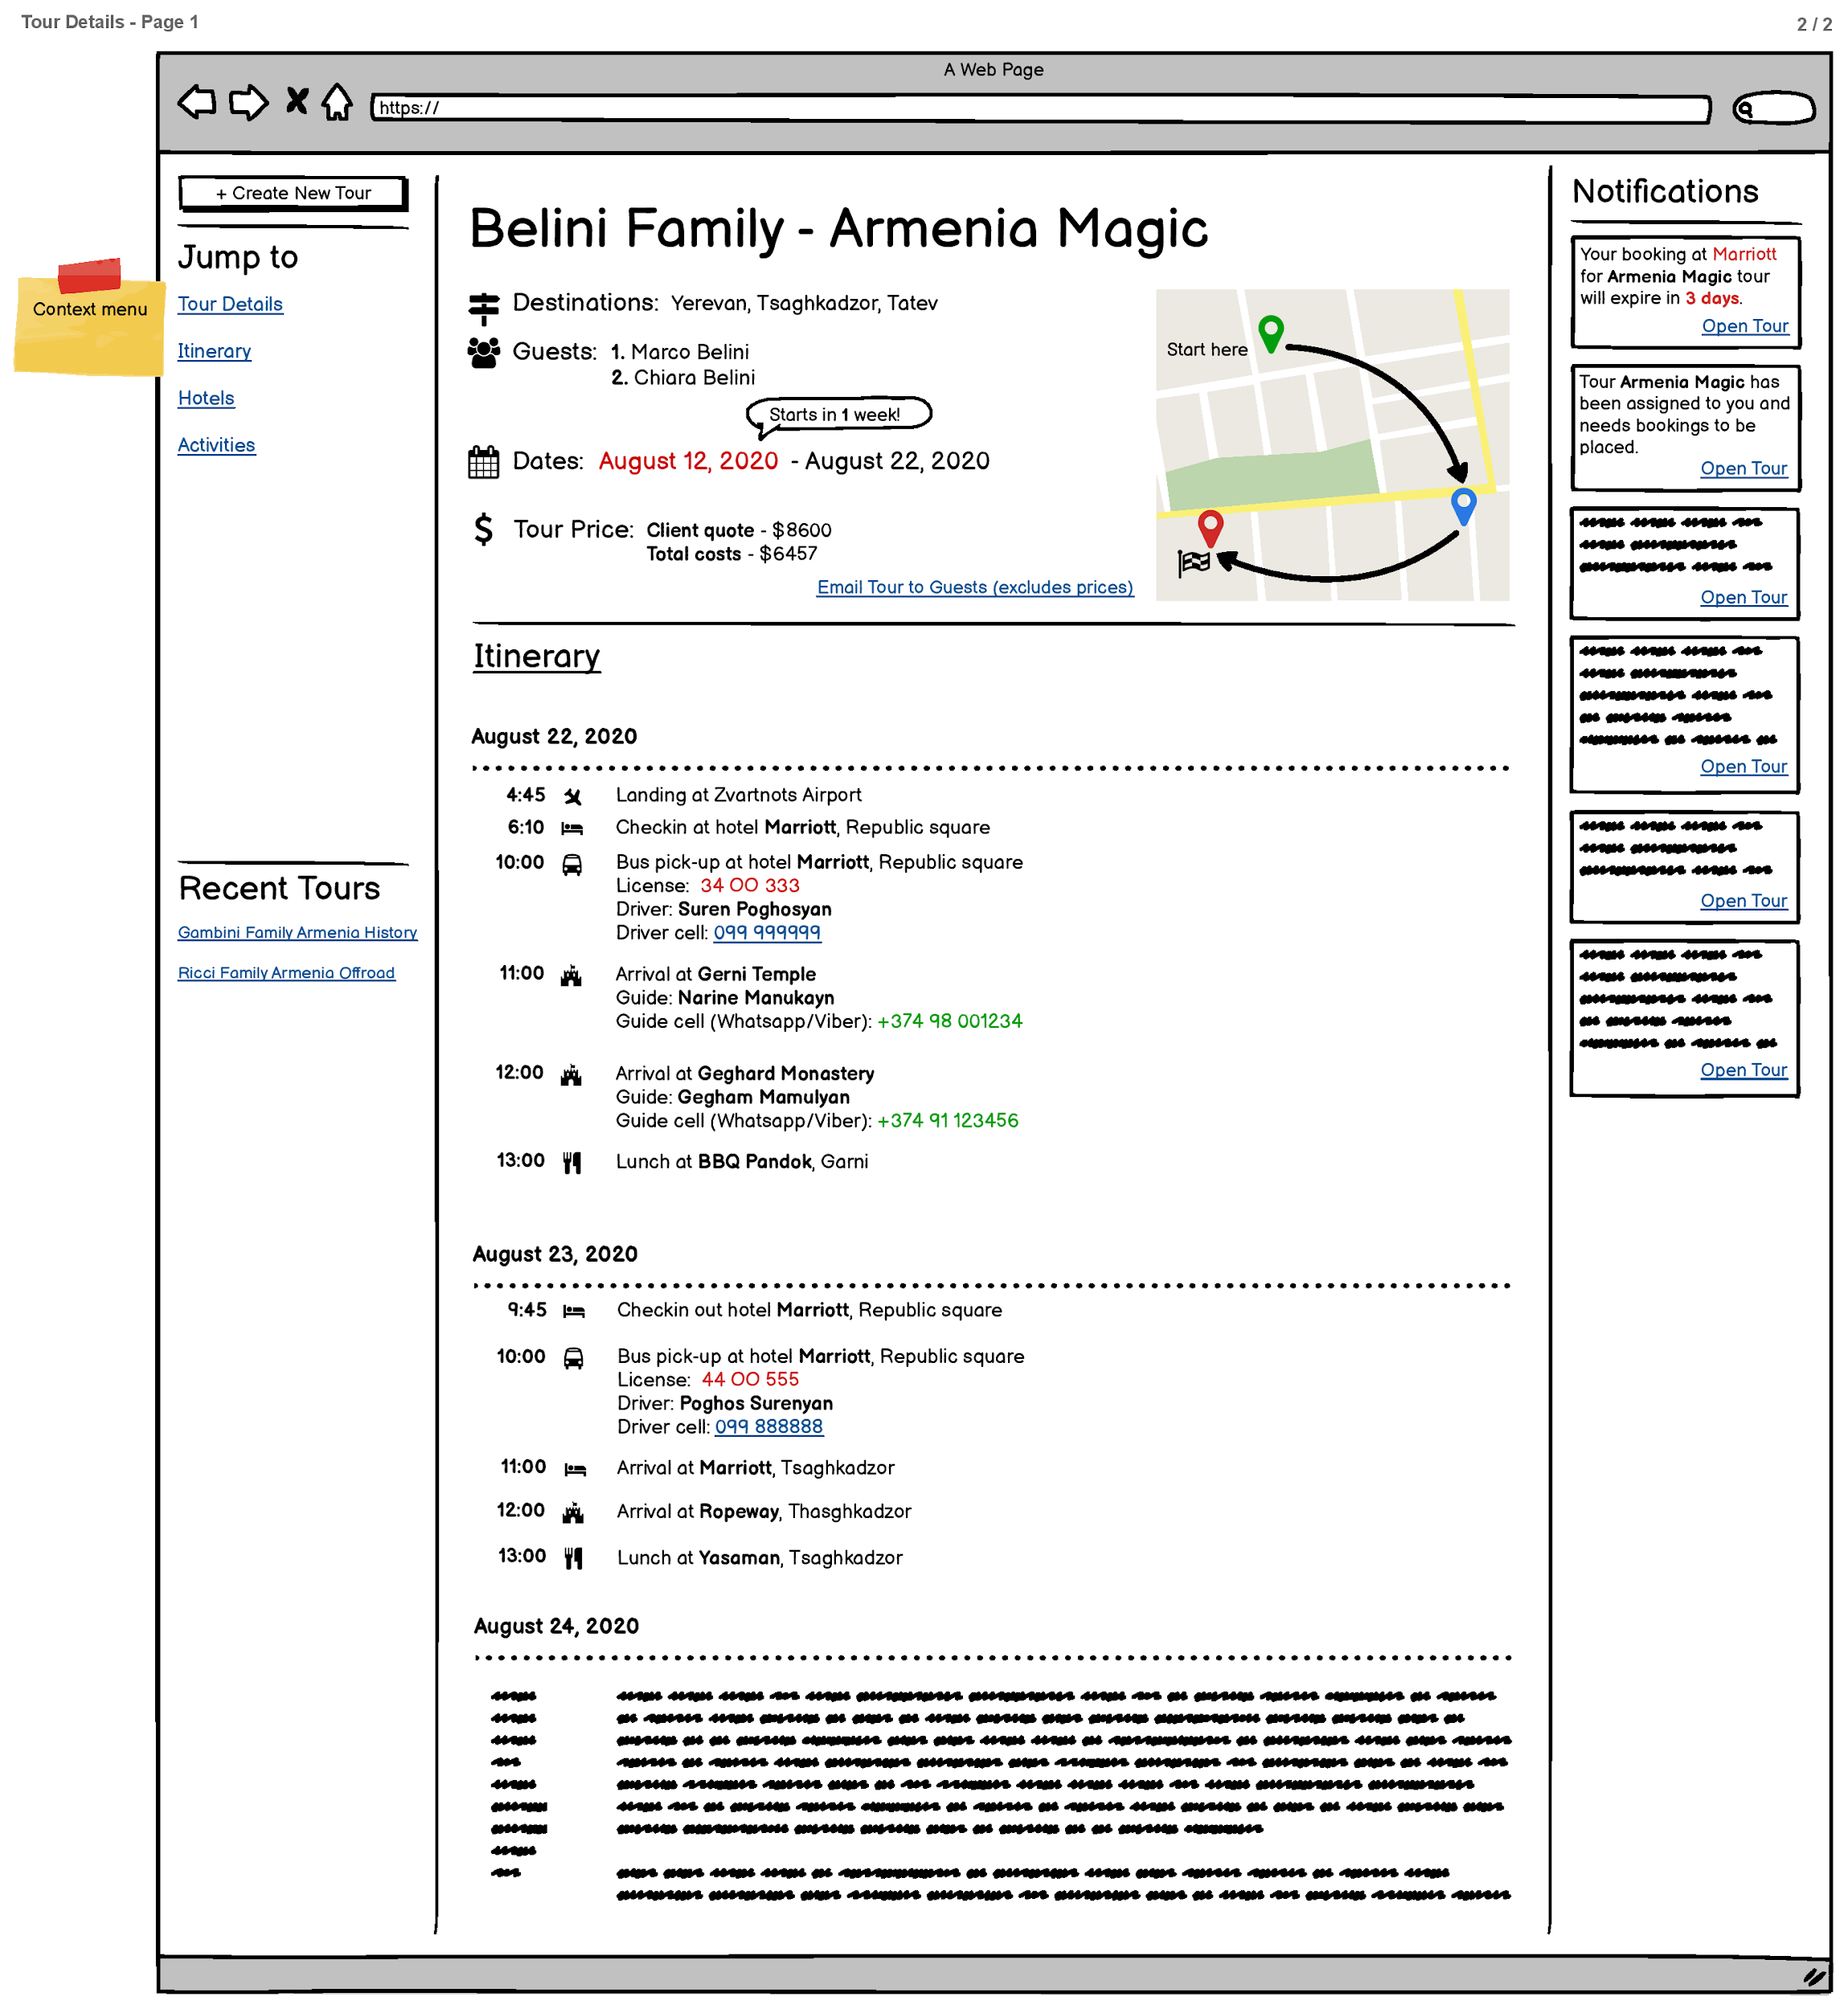

Slide 12
Technical Discussion

